Slide 1
Enhanced HRSN Nutrition: Cooking Supplies
Updated 1/6/25

Slide 2
Confidentiality Statement
This Social Care Network (SCN) Training Guide, and all information contained herein, are created by and the property of Care Compass Collaborative and is considered strictly confidential information. Unauthorized use, duplication, or redisclosure of the information is prohibited without prior written authorization by Care Compass Collaborative.
The information is intended only for organizations' use to train, prepare, and support staff for roles within the SCN, and may not be reproduced, republished, distributed, transmitted, displayed, or broadcast to any other parties, either internally or externally, that are not directly involved in the SCN.

Slide 3
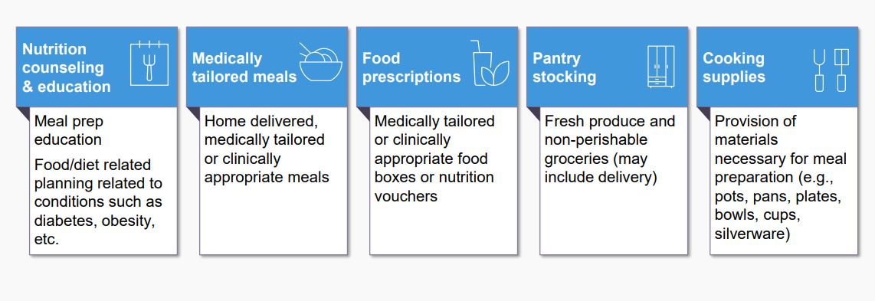
Enhanced HRSN Nutrition Services
Nutrition Service Providers must have knowledge of principles, methods, and procedures of the nutrition services covered under the 1115 waiver, or comparable services meant to support an individual in obtaining food security and meeting their nutritional needs. Nutrition service providers must follow best practice guidelines and industry standards for food safety.

Slide 4
Nutrition Screening Question and Social Risk Factors
Accountable Health Communities (AHC) HRSN Food Security Screening Questions
Within the past 12 months, you worried that your food would run out before you got money to buy more. | Often true Sometimes true Never true
Within the past 12 months, the food you bought just didn't last and you didn't have money to get more. | Often true Sometimes true Never true
Risk Factor Description: An individual who screens often true or sometimes true to the nutrition questions on the AHC HRSN Screening Tool and meets the USDA definition of low food security in which the individual reports reduced quality, variety, or desirability of diet; little or no indication of reduced food intake; or very low food security in which the person reports multiple indications of disrupted eating patterns and reduced food intake.

Slide 5
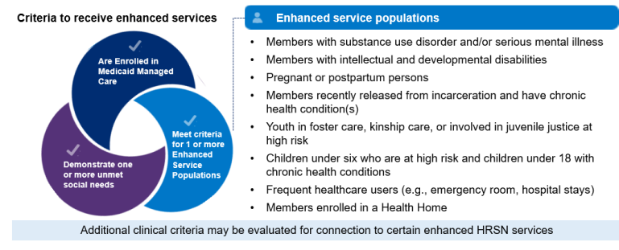
Member Eligibility for Cooking Supplies
Eligible Population: All Enhanced Populations
Social Risk Factor: An individual who is assessed to have unmet HRSN(s) under the food security domain and meets the USDA definition of low or very low food security as determined by having an unmet HRSN need under food security domain per AHC screening tool.
Clinical Criteria: Enhanced Population

Slide 6
Cooking Supplies
Cooking Supplies that are necessary for meal preparation and nutritional welfare when not available through other programs.
Social Care Navigator will determine the specific needs of each Member (e.g. Member with a change in housing who require a full set of cooking supplies vs. another Member who require a replacement microwave only).
Cooking supplies include:
  Kitchenware: Pots and pans, chef's knife, mixing bowls, cooking utensils, cutting board, eating utensils, plates, bowls, glassware, silverware, can opener, and colander
  Microwave
  Mini-refrigerator

Slide 7
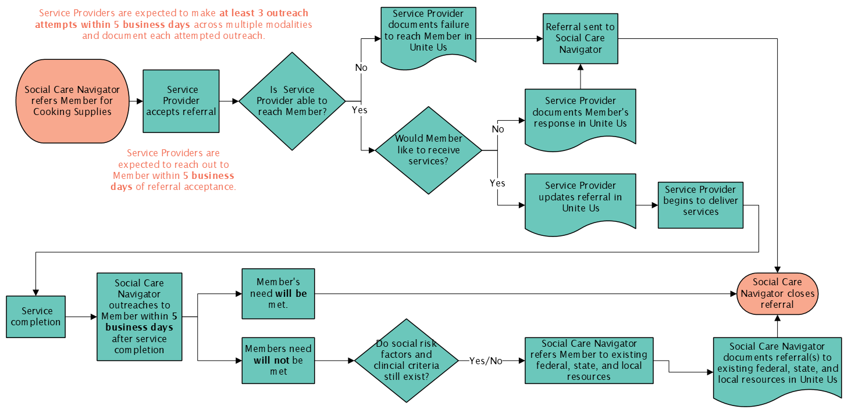
Cooking Supplies Workflow

Slide 8
Reimbursement for HRSN Service Provision
Service providers may bill and be reimbursed for services delivered in accordance with the regional fee schedule established by the SCN Lead Entity. HRSN service providers may be paid for screening and services delivered if…
They are contracted with the SCN Lead Entity
Member was referred to the HRSN service provider through the SCN referral pathway (by a Social Care Navigator using Unite Us)
  If the Member was referred through an alternative pathway outside of the SCN (e.g., through an existing grant program), the provider cannot bill for the services delivered to the SCN and should use existing funding.
  If the service provider thinks the Member is eligible for appropriate enhanced HRSN services, the service provider can direct the Member to the SCN Lead Entity to get a referral.
Member is eligible for the HRSN service as determined by the SCN program; for enhanced HRSN services, eligibility requires Members to be enrolled in Medicaid Managed Care, meet specific enhanced population and clinical criteria, and demonstrate unmet health-related social needs determined by the SCN program
Services delivered are among the services approved by the SCN program (see https://www.health.ny.gov/health_care/medicaid/redesign/sdh/scn/index.htm)
HRSN service provider follows any additional agreed upon terms as outlined in contracts with SCN Lead Entities

Slide 9
Cooking Supplies Reimbursement
Cooking Supplies
  Kitchenware: $350 capped amount, including delivery. A max amount of $55 can be used for admin time and/or mileage if delivery is not available. Eligible items include pots and pans, chef's knife, mixing bowls, cooking or eating utensils, cutting board, plates, bowls, glassware, silverware, can opener, and/or colander.
  Microwave: $120 capped amount, including delivery. Max amount of $20 may be for admin/mileage.
  Mini refrigerator: $295 capped amount, including delivery. Max amount of $45 may be used for admin/mileage.
Setting: Cooking supplies may be purchased online or in-person
Duration: Cooking supplies are available one-time during the Waiver period per Member
Maximum: Up to capped amount during the waiver period if Member is eligible
Notes:
changed

Slide 10
Cooking Supplies Reimbursement
Item | Material/Delivery | Administrative Time/Mileage* | Funding Cap
Kitchenware | $300 | $0-$55 | $355
Microwave | $100 | $0-$20 | $120
Mini-refrigerator | $250 | $0-$45 | $295
Setting: Cooking supplies should be purchased online. If item(s) are unavailable for online purchase, an in-person cooking supply purchase may be made.
Duration: Cooking supplies are available one-time during the Waiver period per Member
Maximum: Up to capped amount during the waiver period if Member is eligible
*Administrative time includes time associated with shopping for cooking supplies online. If item(s) are unavailable for online purchase, mileage may be used.
Notes:
changed

Slide 11
Enhanced HRSN Nutrition: Cooking Supplies

