Slide 1
Enhanced HRSN Nutrition:
Medically Tailored or Clinically Appropriate Food Prescriptions
Updated 1/13/25

Slide 2
Confidentiality Statement
This Social Care Network (SCN) Training Guide, and all information contained herein, are created by and the property of Care Compass Collaborative and is considered strictly confidential information. Unauthorized use, duplication, or redisclosure of the information is prohibited without prior written authorization by Care Compass Collaborative.
The information is intended only for organizations' use to train, prepare, and support staff for roles within the SCN, and may not be reproduced, republished, distributed, transmitted, displayed, or broadcast to any other parties, either internally or externally, that are not directly involved in the SCN.

Slide 3
Enhanced HRSN Nutrition Services
Nutrition Service Providers must have knowledge of principles, methods, and procedures of the nutrition services covered under the 1115 waiver, or comparable services meant to support an individual in obtaining food security and meeting their nutritional needs. Nutrition service providers must follow best practice guidelines and industry standards for food safety.

Slide 4
Nutrition Screening Question and Social Risk Factors
Accountable Health Communities (AHC) HRSN Food Security Screening Questions
Within the past 12 months, you worried that your food would run out before you got money to buy more. | Often true Sometimes true Never true
Within the past 12 months, the food you bought just didn't last and you didn't have money to get more. | Often true Sometimes true Never true
Risk Factor Description: An individual who screens often true or sometimes true to the nutrition questions on the AHC HRSN Screening Tool and meets the USDA definition of low food security in which the individual reports reduced quality, variety, or desirability of diet; little or no indication of reduced food intake; or very low food security in which the person reports multiple indications of disrupted eating patterns and reduced food intake.

Slide 5
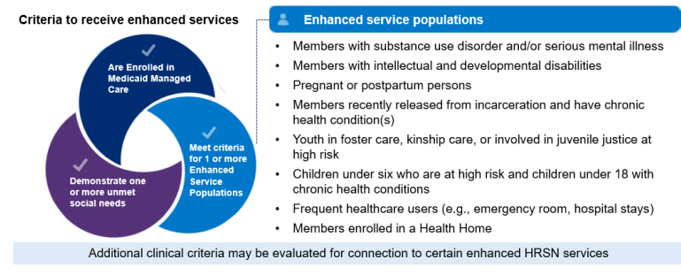
Member Eligibility for Medically Tailored or Nutritionally Appropriate Food Prescriptions
Eligible Population: All Enhanced Populations
Social Risk Factor: An individual who is assessed to have unmet HRSN(s) under the food security domain and meets the USDA definition of low or very low food security as determined by having an unmet HRSN need under food security domain per AHC screening tool.
Clinical Criteria: Enhanced Population

Slide 6
Medically Tailored or Clinically Appropriate Food Prescriptions
Members may elect to receive this service either as a nutritional voucher or food boxes.
Nutrition Vouchers:
Medically tailored or nutritionally appropriate food prescriptions issued in the form of vouchers or coupons may only be redeemed at food pharmacies, food pantries, grocery stores, farmer's markets, mobile markets, and Community Supported Agriculture (CSA) subscriptions.
Vouchers will have a stated dollar amount to reasonably cover the cost of preparing 21 nutritious meals per week.
Food Boxes:
Approved by a Registered Dietitian Nutritionist (RDN) or Certified Dietitian Nutritionist (CDN) and designed to improve health outcomes, lower cost of care, and increase Member satisfaction.
Boxes will include enough delivered items per box to create an estimated 3 meals a day, 7 days a week (21 total meals) with the amount of food meeting the Hunger Prevention and Nutritional Assistance Program (HPNAP) recommendations and should follow appropriate nutritional standards.

Slide 7
Medically Tailored or Clinically Appropriate Food Prescriptions Service Restrictions
Service is limited to weekly delivery of food appropriate for compete weekly meals.
Service is limited to three (3) prepared meals a day for up to 6 months at a time.
If the member is a child/adolescent (0-21 years of age) or a pregnant person meeting needs-based criteria, additional meal support may be provided for eligible household members as determined by individual Screening and Eligibility Assessments.
Meals can only be delivered to the enrolled Member's home or private residence.
Members who receive Medically Tailored or Nutritionally Appropriate Food Prescriptions cannot also receive Fresh Produce and Non-Perishable Groceries (Pantry Stocking) or Medically Tailored Meals or Clinically Appropriate Home Delivered Meals.

Slide 8
Medically Tailored or Clinically Appropriate Food Prescriptions Service Restrictions
Pregnant or postpartum Members may receive services either throughout their pregnancy and up to 12 months postpartum, or for up to 6 months. Services may be renewed for up to 6 months if clinical and social needs factors still apply. For the latter option, the timing of eligibility determination during pregnancy or postpartum period does not affect the allowable duration of benefit. The intervention may apply to subsequent pregnancies/postpartum periods during the demonstration period if the Member meets the needs-based clinical criteria at the time of the subsequent pregnancies/postpartum periods.

Slide 9
Households Guidance for Navigation to Nutrition Enhanced HRSN Services
Service Category | Services | Potential OHIP Guidance (Based on HRSN Fee Schedule v2)
Nutrition | Medically Tailored or Nutritionally Appropriate Food Prescriptions | OHIP has set household-level ranges based on the number of Members in a household who are eligible for Medically Tailored or Nutritionally Appropriate Food Prescriptions. As part of the Enhanced HRSN Care Management process, the Social Care Navigator will determine how many Members in a household will receive Medically Tailored or Nutritionally Appropriate Food Prescriptions.

Slide 10
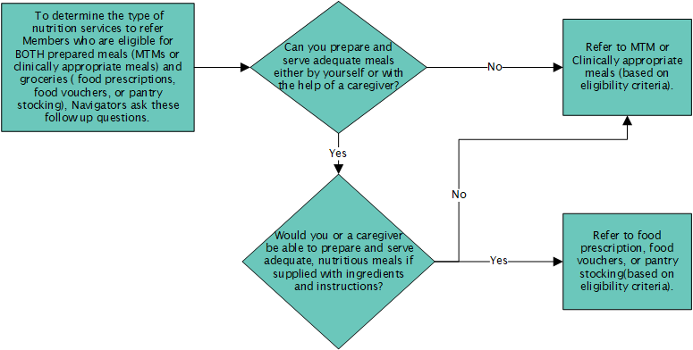
Considerations for Navigating Members to Nutrition Enhanced HRSN Services
When navigating Members to Enhanced HRSN Services, Navigators should determine the type of nutrition services that are appropriate for each Member based on their unique needs and eligibility criteria.
During the Eligibility Assessment, for Members who are eligible for BOTH prepared meals (medically tailored meals or clinically appropriate meals) and groceries (food prescriptions, food vouchers, or pantry stocking), Navigators are encouraged to ask additional follow-up questions.

Slide 11
Medically Tailored or Nutritionally Appropriate Food Prescriptions Workflow

Slide 12
Reimbursement for HRSN Service Provision
Service providers may bill and be reimbursed for services delivered in accordance with the regional fee schedule established by the SCN Lead Entity. HRSN service providers may be paid for screening and services delivered if…
They are contracted with the SCN Lead Entity
Member was referred to the HRSN service provider through the SCN referral pathway (by a Social Care Navigator using Unite Us)
If the Member was referred through an alternative pathway outside of the SCN (e.g., through an existing grant program), the provider cannot bill for the services delivered to the SCN and should use existing funding.
If the service provider thinks the Member is eligible for appropriate enhanced HRSN services, the service provider can direct the Member to the SCN Lead Entity to get a referral.
Member is eligible for the HRSN service as determined by the SCN program; for enhanced HRSN services, eligibility requires Members to be enrolled in Medicaid Managed Care, meet specific enhanced population and clinical criteria, and demonstrate unmet health-related social needs determined by the SCN program
Services delivered are among the services approved by the SCN program (see https://www.health.ny.gov/health_care/medicaid/redesign/sdh/scn/index.htm)
HRSN service provider follows any additional agreed upon terms as outlined in contracts with SCN Lead Entities

Slide 13
Medically Tailored or Clinically Appropriate Food Prescriptions Reimbursement
Pricing Unit: A unit is defined as per day.
Unit Max: up to $21/day
Setting:
Food prescriptions issues in the form of vouchers or coupons may be redeem at food pharmacies, food pantries, grocery stores, farmer's markets, mobile markets, and Community Supported Agriculture (CSA) subscriptions.
Member who opt for food boxes will receive a weekly delivery of fruits, vegetables, and protein boxes.
Duration: Up to 6 months with possibility of reauthorization. Months do not need to be consecutive.
up to 6 months, with possibility of renewal for an additional 6 months. Pregnant / postpartum individuals (up to 12 months postpartum) may be re-authorized for 6 months upon subsequent pregnancy during the Waiver period, with possibility of renewal for an additional 6 months.
Pending CMS approval
Notes:
changed

Slide 14
Additional Reimbursement Information- Households
Number of Members Eligible per Household | Reimbursement Range per week
1 | $97 - $146
2 | $189 - $227
3 | $255 - $304
4 | $324 - $373
5 | $385 - $434
6 | $462 - $511
7 | $510 - $559
8 | $583 - $632

Slide 15
Enhanced HRSN Nutrition:
Medically Tailored or Clinically Appropriate Food Prescriptions

