Slide 1
Enhanced HRSN Nutrition:
Clinically Appropriate Home Delivered Meals
Updated 1/13/25

Slide 2
Confidentiality Statement
This Social Care Network (SCN) Training Guide, and all information contained herein, are created by and the property of Care Compass Collaborative and is considered strictly confidential information. Unauthorized use, duplication, or redisclosure of the information is prohibited without prior written authorization by Care Compass Collaborative.
The information is intended only for organizations' use to train, prepare, and support staff for roles within the SCN, and may not be reproduced, republished, distributed, transmitted, displayed, or broadcast to any other parties, either internally or externally, that are not directly involved in the SCN.

Slide 3
Enhanced HRSN Nutrition Services
Nutrition Service Providers must have knowledge of principles, methods, and procedures of the nutrition services covered under the 1115 waiver, or comparable services meant to support an individual in obtaining food security and meeting their nutritional needs. Nutrition service providers must follow best practice guidelines and industry standards for food safety.

Slide 4
Nutrition Screening Question and Social Risk Factors
Accountable Health Communities (AHC) HRSN Food Security Screening Questions
Within the past 12 months, you worried that your food would run out before you got money to buy more. | Often true Sometimes true Never true
Within the past 12 months, the food you bought just didn't last and you didn't have money to get more. | Often true Sometimes true Never true
Risk Factor Description: An individual who screens often true or sometimes true to the nutrition questions on the AHC HRSN Screening Tool and meets the USDA definition of low food security in which the individual reports reduced quality, variety, or desirability of diet; little or no indication of reduced food intake; or very low food security in which the person reports multiple indications of disrupted eating patterns and reduced food intake.

Slide 5
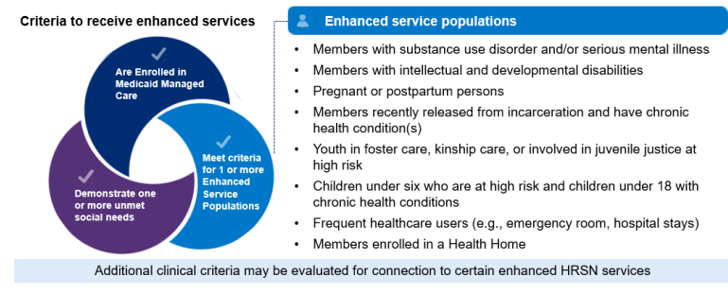
Member Eligibility for Clinically Appropriate Home Delivered Meals
Eligible Population: All Enhanced Populations
Social Risk Factor: An individual who is assessed to have unmet HRSN(s) under the food security domain and meets the USDA definition of low or very low food security as determined by having an unmet HRSN need under food security domain per AHC screening tool.
Cannot prepare their own meals
Clinical Criteria:
Enhanced Population

Slide 6
Clinically Appropriate Home Delivered Meals
Meal plans will be approved by a Registered Dietitian Nutritionist (RDN) or Certified Dietitian Nutrionist (CDN) and designed to improve health outcomes, lower cost of care, and increase Member satisfaction.
Meals must provide well-balanced, nutritionally appropriate meals that adhere to evidence-based nutritional guidelines.
Meals promote health and wellness for Enhanced populations who have an unmet HRSN under the food domain and meet the USDA definition of low food security but do not have chronic conditions and are not pregnant/postpartum persons.
All meals must adhere to standards informed by appropriate nutrition guidelines.

Slide 7
Clinically Appropriate Home Delivered Meals Service Restrictions
Service is limited to three (3) prepared meals a day, seven days a week for up to 6 months at a time
If the Member is a child/adolescent (0-21 years) or a pregnant person meeting needs-based criteria, additional meal support may be provided for the household as determined by individual Screening and Eligibility Assessments.
Meals can only be delivered to the enrolled Member's home or private residence.
Members who receive Clinically Appropriate Meals cannot also receive Medically Tailored Meals, Fresh Produce and Non-Perishable Groceries (Pantry Stocking), or Medically Tailored/Nutritionally Appropriate Food Prescriptions.

Slide 8
Clinically Appropriate Home Delivered Meals Service Restrictions
Pregnant or postpartum Members may receive services either throughout their pregnancy and up to 12 months postpartum, or for up to 6 months. Services may be renewed for up to 6 months if clinical and social needs factors still apply. For the latter option, the timing of eligibility determination during pregnancy or postpartum period does not affect the allowable duration of benefit. The intervention may apply to subsequent pregnancies/postpartum periods during the demonstration period if the Member meets the needs-based clinical criteria at the time of the subsequent pregnancies/post-partum periods.

Slide 9
Households Guidance for Navigation to Nutrition Enhanced HRSN Services
Service Category | Services | Potential OHIP Guidance (Based on HRSN Fee Schedule v2)
Nutrition | Medically Tailored Meals and Clinically Appropriate Home Delivered Meals | As part of the Enhanced HRSN Care Management process, the Social Care Navigator will determine the number of eligible Members in a household and facilitate efficient service delivery (e.g. ensure meals for Members sharing a household come from the same HRSN service provider, streamline delivery costs by ensuring meals for the same household are delivered in a single trip, etc.).

Slide 10
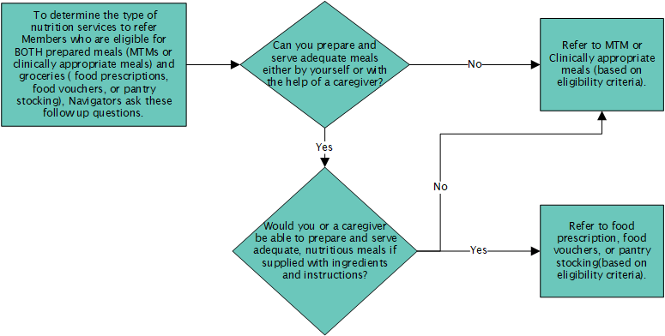
Considerations for Navigating Members to Nutrition Enhanced HRSN Services
When navigating Members to Enhanced HRSN Services, Navigators should determine the type of nutrition services that are appropriate for each Member based on their unique needs and eligibility criteria.
During the Eligibility Assessment, for Members who are eligible for BOTH prepared meals (medically tailored meals or clinically appropriate meals) and groceries (food prescriptions, food vouchers, or pantry stocking), Navigators are encouraged to ask additional follow-up questions.

Slide 11
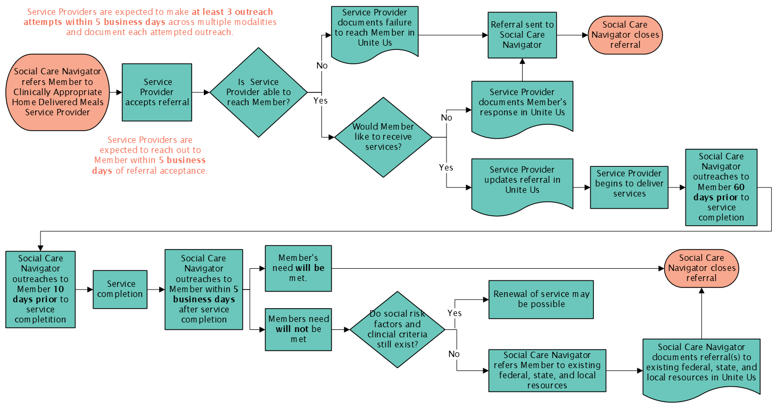
Clinically Appropriate Home Delivered Meals Workflow

Slide 12
Reimbursement for HRSN Service Provision
Service providers may bill and be reimbursed for services delivered in accordance with the regional fee schedule established by the SCN Lead Entity. HRSN service providers may be paid for screening and services delivered if…
They are contracted with the SCN Lead Entity
Member was referred to the HRSN service provider through the SCN referral pathway (by a Social Care Navigator using Unite Us)
If the Member was referred through an alternative pathway outside of the SCN (e.g., through an existing grant program), the provider cannot bill for the services delivered to the SCN and should use existing funding.
If the service provider thinks the Member is eligible for appropriate enhanced HRSN services, the service provider can direct the Member to the SCN Lead Entity to get a referral.
Member is eligible for the HRSN service as determined by the SCN program; for enhanced HRSN services, eligibility requires Members to be enrolled in Medicaid Managed Care, meet specific enhanced population and clinical criteria, and demonstrate unmet health-related social needs determined by the SCN program
Services delivered are among the services approved by the SCN program (see https://www.health.ny.gov/health_care/medicaid/redesign/sdh/scn/index.htm)
HRSN service provider follows any additional agreed upon terms as outlined in contracts with SCN Lead Entities

Slide 13
Clinically Appropriate Home Delivered Meals Reimbursement
Pricing Unit: A unit is defined as per day (for Care Compass)
Unit Max: $48/day, $8,640 total cap for waiver period
$10 - $16 per meal
Setting: Not applicable.
Duration: Up to 6 months with possibility of reauthorization. Months do not need to be consecutive.
Eligible Members may receive this service for up to 6 months, with possibility of renewal for an additional 6 months. Pregnant / postpartum individuals (up to 12 months postpartum) may be re-authorized for 6 months upon subsequent pregnancy during the Waiver period, with possibility of renewal for an additional 6 months.
Pending CMS approval
Notes:
changed

Slide 14
Enhanced HRSN Nutrition:
Clinically Appropriate Home Delivered Meals

