Slide 1
Enhanced HRSN Housing:
Pre-Tenancy Services
Updated 1/6/25

Slide 2
Confidentiality Statement
This Social Care Network (SCN) Training Guide, and all information contained herein, are created by and the property of Care Compass Collaborative and is considered strictly confidential information. Unauthorized use, duplication, or redisclosure of the information is prohibited without prior written authorization by Care Compass Collaborative.
The information is intended only for organizations' use to train, prepare, and support staff for roles within the SCN, and may not be reproduced, republished, distributed, transmitted, displayed, or broadcast to any other parties, either internally or externally, that are not directly involved in the SCN.

Slide 3
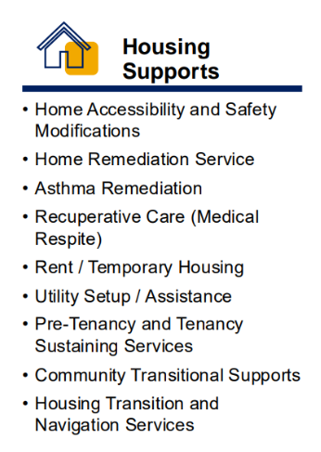
Enhanced HRSN Housing Services
Housing support service providers are critical to expand access to vital services in our communities. Providers who join a Social Care Network can be reimbursed for delivery of services to qualifying Medicaid Members and for supporting Member navigation as part of this Medicaid program.

Slide 4
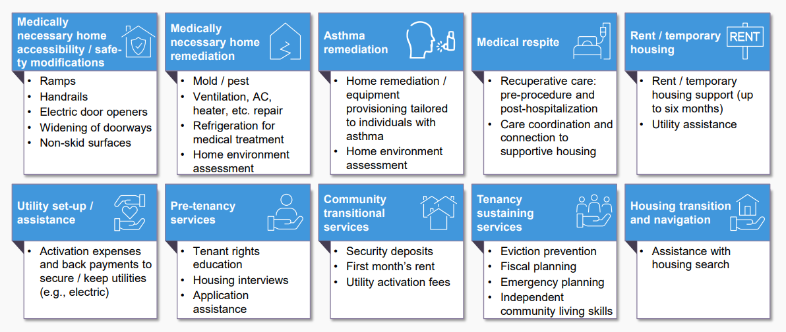
Enhanced HRSN Housing Services

Slide 5
AHC HRSN Screening Tool Question and Related Positive Unmet Need Response | Risk Factor Description
What is your living situation today? I have a steady place to live I have a place to live today, but I am worried about losing it in the future I do not have a steady place to live (I am temporarily staying with others, in a hotel, in a shelter, living outside on the street, on a beach, in a car, abandoned building, bus or train station, or in a park) | An individual who: Is homeless or at risk of becoming homeless, as defined by the U.S. Department of Housing and Urban Development (HUD) in 24 CFR 91.5), except for the annual income requirement in 24 CFR 91.5 (1)(i)). Transitioned out of institutional care / congregate settings such as nursing facilities, large group homes, congregate residential settings, IMDs, correctional facilities, State Psychiatric, State or Voluntary Community Residence, Single Room Occupancy (SRO), and acute care hospitals within the past 90 days or Youth transitioning out of the child welfare system including foster care. Requires a clinically appropriate home modification / remediation service. Resides in their own home or non-institutional primary residence and for whom an air conditioner, heater, air filtration device, and/or refrigeration unit for medications or breast milk is clinically appropriate as a component of health services treatment or prevention.

Slide 6
AHC HRSN Screening Tool Question and Related Positive Unmet Need Response | Risk Factor Description
Think about the place you live. Do you have problems with any of the following? CHOOSE ALL THAT APPLY Pests such as bugs, ants, or mice Mold Lead paint or pipes Lack of heat Oven or stove not working Smoke detectors missing or not working Water leaks None of the above | An individual who: Requires a clinically appropriate home modification / remediation service. Has a health condition that is exacerbated by the individuals physical living environment.
In the past 12 months has the electric, gas, oil, or water company threatened to shut off services in your home? Yes No Already shut off | An individual who: Is homeless or at risk of becoming homeless, as defined by the U.S. Department of Housing and Urban Development (HUD) in 24 CFR 91.5 , except for the annual income requirement in 24 CFR 91.5 (1)(i)). Transitioned out of institutional care / congregate settings such as nursing facilities, large group homes, congregate residential settings, IMDs, correctional facilities, State Psychiatric, State or Voluntary Community Residence, Single Room Occupancy (SRO), and acute care hospitals within the past 90 days or Youth transitioning out of the child welfare system including foster care.

Slide 7
Criteria for Pre-Tenancy Services
Service | Eligible Population | Social Risk Factor | Clinical Criteria
Pre-Tenancy Services | Meets at least one of the Enhanced Population criteria for Enhanced HRSN Services: Members with substance use disorder and/or serious mental illness Members with intellectual and developmental disabilities Pregnant or postpartum persons Members recently released from incarceration and have chronic health condition(s) High risk children under 18 (including justice involved youth, foster care youth, and those under kinship care) Frequent health care users (e.g., emergency room, hospital stays, transitioning from an institutional setting) Members enrolled in a Health Home | An individual who is assessed to have unmet HRSN(s) under housing / utilities domain; and Individual is homeless or at risk of becoming homeless as defined by the U.S. Department of Housing and Urban Development (HUD) in 24 CFR 91.5, except for the annual income requirement in 24 CFR 91.5 (1)(i). | Meets at least one of the Enhanced Population criteria for Enhanced HRSN Services: Members with substance use disorder and/or serious mental illness Members with intellectual and developmental disabilities Pregnant or postpartum persons Members recently released from incarceration and have chronic health condition(s) High risk children under 18 (including justice involved youth, foster care youth, and those under kinship care) Frequent health care users (e.g., emergency room, hospital stays, transitioning from an institutional setting) Members enrolled in a Health Home *Additional clinical criteria may be evaluated for certain enhanced HRSN services
Member must be Enrolled in Medicaid Managed Care.

Slide 8
Pre-Tenancy Services
Service Delivery: Service to assist with navigating the complexities of the housing application and supporting the Member when undergoing tenant screening, completing rental applications, negotiating lease agreements, and preparing for and attending tenant interviews.
Assistance with the housing search and application process, including contacting prospective housing options for availability and information, as well as researching the availability of rental assistance.

Slide 9
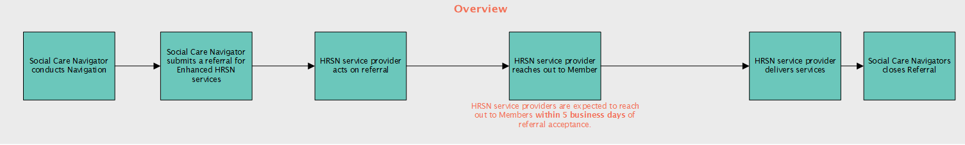
SCN Referral Process
Referrals are made by Social Care Navigators to HRSN service providers.
The process from initial Referral through service completion and Referral closure is below:

Slide 10
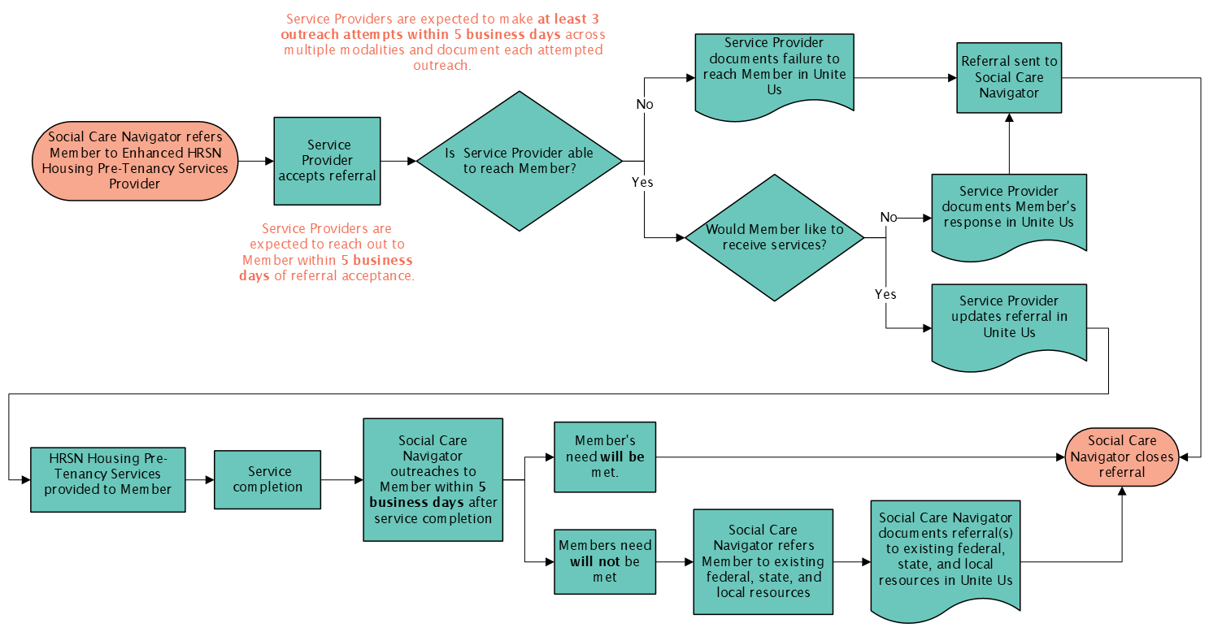
Pre-Tenancy Services Workflow

Slide 11
Pre-Tenancy Services Reimbursement
Services include:
Housing Application Assistance and Information
Lease Agreement Negotiation Assistance
Tenant Interview Preparation
Tenant Screening Assistance
Pricing Unit: A unit is defined as a 15 minute engagement, reimbursed at $17.50 per unit
Unit Max: 24 units over six (6) months
Setting: There is not a required setting.
Duration: Up to six (6) months. Months do not need to be consecutive.
Pending CMS approval
Notes:
changed

Slide 12
"8-minute rule" for billing
Units | Lower bound (min.) | Upper bound (min.)
1 | ≥ 8 | 22
2 | ≥ 23 | 37
3 | ≥ 38 | 52
4 | ≥ 53 | 67
5 | ≥ 68 | 82
6 | ≥ 83 | 87
7 | ≥ 98 | 112
8 | ≥ 113 | 127
For any timed code measured in 15-minute units, providers may bill a single 15-minute unit for service duration greater than or equal to 8 minutes through and including 22 minutes.

Slide 13
Reimbursement for HRSN Service Provision
Service providers may bill and be reimbursed for services delivered in accordance with the regional fee schedule established by the SCN Lead Entity. HRSN service providers may be paid for screening and services delivered if…
They are contracted with the SCN Lead Entity
Member was referred to the HRSN service provider through the SCN referral pathway (by a Social Care Navigator using Unite Us)
  If the Member was referred through an alternative pathway outside of the SCN (e.g., through an existing grant program), the provider cannot bill for the services delivered to the SCN and should use existing funding.
  If the service provider thinks the Member is eligible for appropriate enhanced HRSN services, the service provider can direct the Member to the SCN Lead Entity to get a referral.
Member is eligible for the HRSN service as determined by the SCN program; for enhanced HRSN services, eligibility requires Members to be enrolled in Medicaid Managed Care, meet specific enhanced population and clinical criteria, and demonstrate unmet health-related social needs determined by the SCN program
Services delivered are among the services approved by the SCN program (see https://www.health.ny.gov/health_care/medicaid/redesign/sdh/scn/index.htm)
HRSN service provider follows any additional agreed upon terms as outlined in contracts with SCN Lead Entities

Slide 14
Enhanced HRSN Housing:
Pre-Tenancy Services

