Slide 1
HRSN Service Delivery in the Social Care Network
Updated 1/6/25

Slide 2
Confidentiality Statement
This Social Care Network (SCN) Training Guide, and all information contained herein, are created by and the property of Care Compass Collaborative and is considered strictly confidential information. Unauthorized use, duplication, or redisclosure of the information is prohibited without prior written authorization by Care Compass Collaborative.
The information is intended only for organizations' use to train, prepare, and support staff for roles within the SCN, and may not be reproduced, republished, distributed, transmitted, displayed, or broadcast to any other parties, either internally or externally, that are not directly involved in the SCN.

Slide 3
Learning Objectives
Understand the HRSN Service provision portion of the Member journey
Understand the HRSN Service provider role within the SCN
Become familiar with the referral process for Enhanced HRSN services
Identify instances where informed consent and disclosures are required

Slide 4
Overview of Member Journey
Social Care Navigators are responsible for initiating referrals for Enhanced HRSN Services to
HRSN service providers, who then contact the Member and initiate service delivery.

Slide 5
Member Journey to HRSN Services

Slide 6
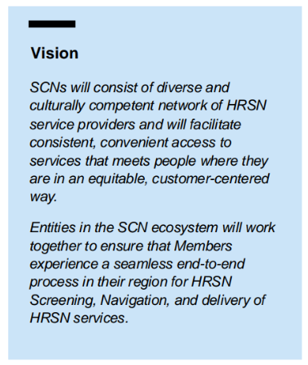
What does the ecosystem of HRSN service providers look like?
Primarily non-profit entities, only including for-profit entities where necessary to support access
Organizations that vary in size and reflect the diversity of their region (e.g., including organizations with an annual budget of less than $5 million)
Have language competencies aligned with the languages that are common and preferred by Medicaid populations of the region
Can meet the unique needs and constraints of Members across the region, including minimizing travel distance for Members and provide services in accessible formats (virtual and in-person)
All interested and eligible organizations to join the Network if there is a reasonable role they can fill

Slide 7
SCN Roles of Enhanced HRSN Service Provider
Any organization providing HRSN services contracted with the SCN for care management, housing, nutrition, and/or transportation services for eligible Medicaid Members.
Enhanced HRSN Service Providers:
May or may not also perform screening and navigation
Must provide status updates on referrals received in Unite Us
Provide narrative reasoning for any non-initiation of services
Update the Social Care Plan
Perform outreach to complete services (more to come at publication of operations manual)
Maintain regional service coverage
Work with the SCN lead to approve services within defined SOW for Home Accessibility and Safety Modifications, Home Remediation Service, and Asthma Remediation.

Slide 10
Considerations for the Enhanced HRSN Services Referral Process
Each referral will be associated with a specific Enhanced HRSN Service (i.e., Members who are eligible for multiple Enhanced HRSN Services will have a separate referral for each Service)
If a Member does not respond to outreach from the contracted HRSN service provider, the contracted HRSN service provider is required to:
Make at least three outreach attempts within five business days
Conduct outreach across multiple modalities (e.g., phone call, text, e-mail)
Document each attempted outreach

Slide 11
Service Delivery Completion: Referral closure

Slide 12
Process Flow for Referrals

Slide 13
HRSN Provider Learns of Additional Needs
If the HRSN service provider learns of another unmet HRSN during service delivery that was not identified during the initial screening, the HRSN service provider cannot directly submit an additional Referral for relevant services, so the Member will be directed to their Navigator.
When a Member's needs change, they will need to be re-screened so that their screening reflects their current needs and additional HRSN services can be provided if the Member is eligible. The Screening tool in Unite Us will have the ability to map Screening answers to codes. LOINC codes will be mapped to reasonable ICD 10 CM and SNOMED codes following the assessment.

Slide 14
Major Life Events Process Flow for HRSN Service Providers
Note: If a Member discloses major life event during the latter part of the member journey the Member will be referred back to their Navigator for Screening.
Notes:
There are instances where a Member will present at a Screening organization and in that case the priority is to meet the Member where they are at. Similarly, organizations who screen and navigate will likely perform re-screenings.

Slide 15
Re-Authorizing Services
What happens when a Member reaches the end of their Enhanced HRSN service delivery and still has an unmet need?
If a Member has reached the maximum units or duration of an Enhanced HRSN service, they cannot renew that service until a new screening has been completed and additional re-authorization criteria are met.
For services that have a maximum per-Member cap, once the Member has reached that cap, they will no longer be able to receive that service under 1115 funding for the remainder of the waiver period.
Navigators can connect Members with federal, state, and local benefits and programs; however, if the Member has reached their limit of Navigation, this Navigation will not be reimbursable through the Social Care Network.
The only services available for renewal/ re-authorization are:
Medically Tailored or Clinically Appropriate Home Delivered Meals
Medically Tailored or Nutritionally Appropriate Food Prescriptions
Fresh Produce and Non-perishable Groceries (Pantry stocking)
Nutritional Counseling & Education
Transportation Services: Public & Private

Slide 16
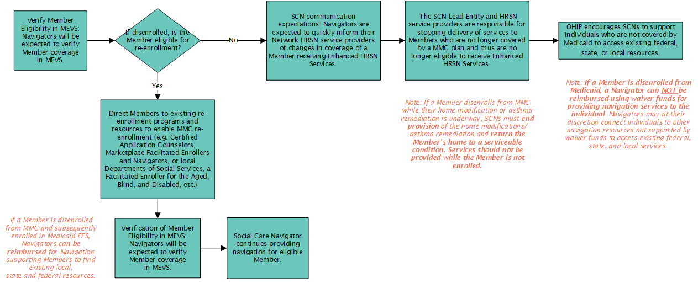
Considerations for Member Changes in Coverage

Slide 17
Reimbursement for CBOS for HRSN Service Provision
Service providers may bill and be reimbursed for services delivered in accordance with the regional fee schedule established by the SCN Lead Entity. HRSN service providers may be paid for screening and services delivered if…
They are contracted with the SCN Lead Entity
Member was referred to the HRSN service provider through the SCN referral pathway (by a Social Care Navigator using Unite Us)
If the Member was referred through an alternative pathway outside of the SCN (e.g., through an existing grant program), the provider cannot bill for the services delivered to the SCN and should use existing funding.
If the service provider thinks the Member is eligible for appropriate enhanced HRSN services , the service provider can direct the Member to the SCN Lead Entity to get a referral.
Member is eligible for the HRSN service as determined by the SCN program; for enhanced HRSN services, eligibility requires Members to be enrolled in Medicaid Managed Care, meet specific enhanced population and clinical criteria, and demonstrate unmet health-related social needs determined by the SCN program
Services delivered are among the services approved by the SCN program (see https://www.health.ny.gov/health_care/medicaid/redesign/sdh/scn/index.htm)
HRSN service provider follows any additional agreed upon terms as outlined in contracts with SCN Lead Entities

Slide 18
Reimbursement for CBOs for HRSN Service Provision- continued
HRSN service providers are able to use multiple funding sources to holistically address Member needs. Braided funding consists of multiple funding sources that are initially separate but, brought together to pay for more than any one funding source can support, and then carefully pulled back apart to report to funders on how the money was spent.
> For example, a Medicaid Member can receive housing navigation under a grant program and then be referred to the SCN to receive community transition service paid through the waiver. Services provided to a Member that are outside the scope of New York Health Equity Reform (NYHER) cannot be reimbursed regardless of whether a Member is concurrently receiving SCN-referred services.
Also to note: HRSN Service Providers or CBOs are allowed to bill for HRSN Services rendered at the same address as a licensed clinic site under Article 28, 31 or 32 (including those funded by local departments of health).

Slide 19
Conclusion
HRSN service providers play a crucial role in the Member journey.
OHIP envisions the Member experience to be seamless from screening to service completion so that Members can access services to meet their needs.
Meet people where they at are in an equitable, person-centered way, take time, offer empathy, tailor where appropriate, and keep the Member central to your "why."

Slide 20
HRSN Service Delivery in the Social Care Network

